Slide 1
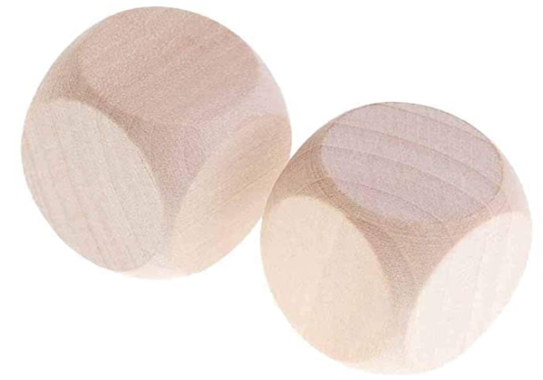

Design 2 dices such that when you roll and add them, it can be any number between 1 to 36. To be more specific it can be all number between 1 and 36.
Dice 1 | Dice 2
So, I am looking for 6 different numbers on each of the dices.

Slide 2
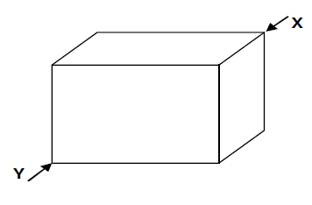

An ant that is in the corner of a room, Y, would like to walk up to the other diagonal corner of the room, X. What is the shortest way for the ant to walk up to other corner of the room?
Oops, ants don’t fly

Slide 3
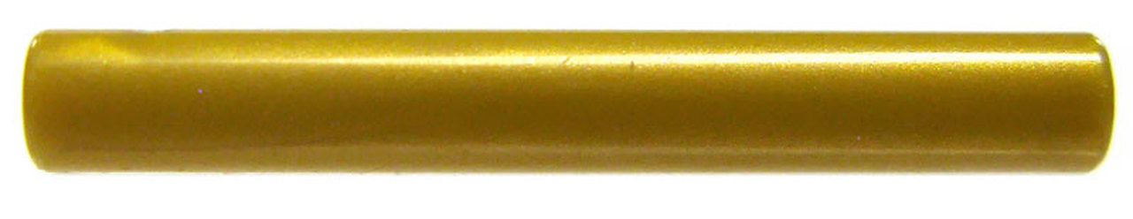

I would like to sell a 15 inch gold bar/rod in all different lengths. Also, I need to make the minimum number of cuts on the bar as it costs me $74 to make a cut.
What is the minimum number of cuts I need to make so that I can make any combination of whole inches (i.e. 1, 2, 3, 4,…, 14, 15 inches) of gold bar?
Don’t tell me we need to cut it into 15 pieces, it’s going to cost me a lot of $$$

Slide 4
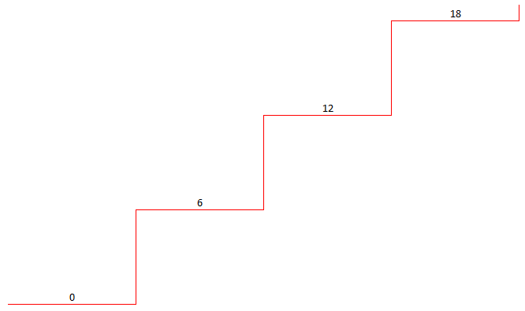
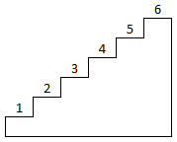
Let’s do our analysis with a base of 6 (hexa).
[0, 6, 12, 18, 24, 30] + [0, 1, 2, 3, 4, 5]
As the minimum value is 1, both the dices cannot start with zero.
Dice 1 | Dice 2
0 | 1
6 | 2
12 | 3
18 | 4
24 | 5
30 | 6
[0, 6, 12, 18, 24, 30]
[1, 2, 3, 4, 5, 6]

Slide 5
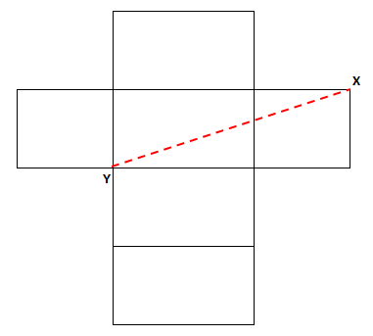

The shortest distance between any 2 points on a plain is a straight line, but the challenge here is that a rectangular prism cannot be on a plane.
But we can always open up the rectangular prism and lay it down on a plane. Now we have converted a 3D problem to 2D problem.
Now, the shortest distance between X and Y is the straight line.
Ahh, ants do walk

Slide 6
Lets do our analysis in binary number of 1s and 0s. We can make all combinations with 3 cuts of lengths 1, 2, 4, 8.
$74 to make 1 cut is “noise” = it is not required for this problem.
Hmm! Once again analysis in the binary world of 1s and 0s.

Slide 7
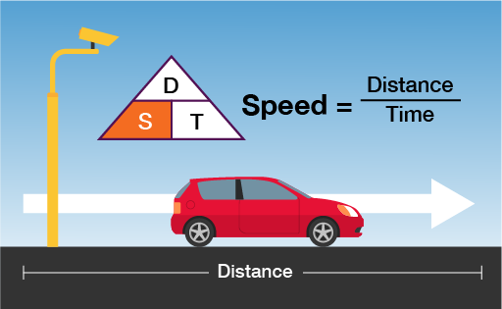

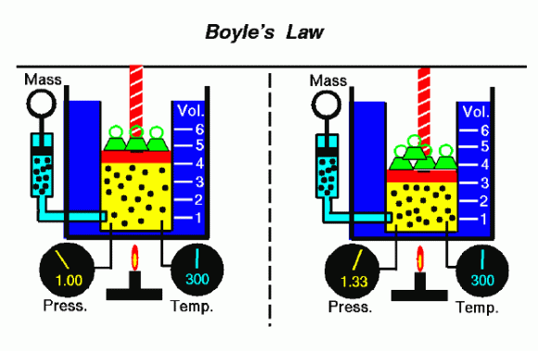
Some subscribers have requested puzzles in physics and chemistry, as well. So watch out for the next video!
Finally, I thank you for watching this video. If you have any questions, please leave them in the comment below.
Also if you want me to make a video in any topic of your interest then please do let me know.
If you like this video then give it a thumbs up and share with your friends, don’t forget to subscribe if you already haven’t. Also please click on the bell button for channel updates.

